Slide 1

<site name>
Logo URL: http://www.perficient.com/~/media/Images/About/perficient_HORIZ_jpg.jpg
Content Placeholder
Username:
Password:
Login

Slide 2
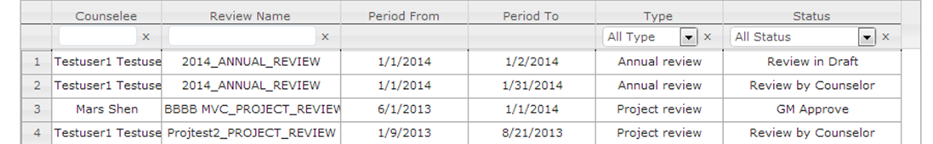
<site name>
Welcome, John Spyers
Logout
My Dashboard
Create My Review
My Work List
Review | Type | Status | Action
Project ABC | Project | Started | Select Peers
Annual Review | Annual | Draft | Edit
In Process Reviews
Reviewee | Review | Type | Status
Last Name, First Name | Project BBB | Project | Status
Last Name, First Name | Title | Annual | Status
My Completed Reviews
Review | Type | Review Period
Project BBB | Project | Start Date – End Date
2013 Annual | Annual | Start Date – End Date
Completed Review for Colleagues

Slide 3
<site name>
Welcome, John Spyers
Logout
My Dashboard
Create My Review
Basic Information | Peer Selection | Review Details
Select Peers
Search for peers by entering their name
Remove All
FirstName LastName Add
FirstName LastName Add
FirstName LastName Add
FirstName LastName Add
FirstName LastName Add
FirstName LastName Remove
FirstName LastName Remove
Peer Status
Name | Status | Action
First Last | Sent | Send a Reminder
First Last | Not Sent | Remove
First Last | Not Sent | Remove

Slide 4
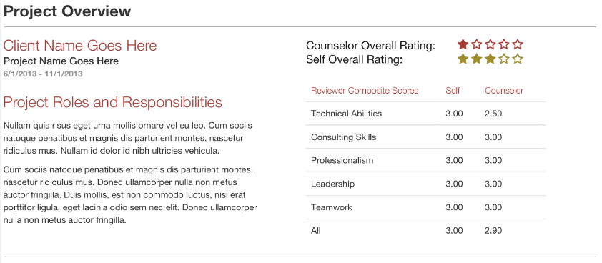
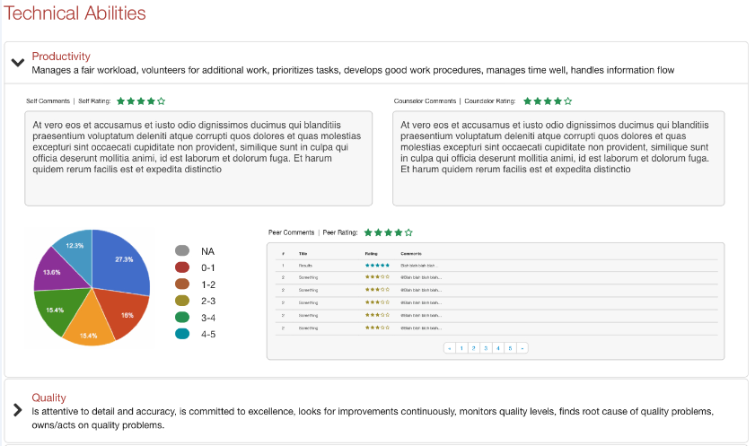
<site name>
Welcome, John Spyers
Logout
My Dashboard
Create My Review
Basic Information | Peer Selection | Review Details

